Slide 1

Alternate Business Modalities for Diversification into Solar Business
Coal India Limited
Mar 2023

Slide 2
Alternate Business Modalities for sale of Solar Power other than Section 63
Alternate options for sale of solar power
1. Sale of Solar Power to RVUNL
2. Sale to DISCOMs u/s 62
3. Sale through Power Exchange
4. Sale through other avenues
5. Sale under CPSU Scheme
6. Captive Consumption
A. Bundling with existing TPPs
B. Bundling with upcoming TPPs
A. Sale to Rajasthan DISCOMs
B. Sale to Other DISCOMs u/s 62
A. Sale to Open Access (C&I)* Consumers
B. Sale through Trading Licensees
* Commercial and Industrial

Slide 3
Options for Location and Types of Role for CIL w.r.t Power Sale from Solar Project
Location Options
Rajasthan Solar Park
Own Land of CIL subsidiaries
Other acquired land in any state
Types of Role for CIL
Solar Power Developer (SPD)
Solar Power Park Developer (SPPD) + SPD
CIL would be majorly responsible for following:
Arrangement of land for non-solar park projects
Design and construction of solar power project
Securing connectivity and associated infrastructure till pooling substation
O&M
CIL may additionally don the role of an SPPD wherein responsibility of arrangement of land, construction of solar park infrastructure as well as availability of evacuation infrastructure inter alia would lie with the SPPD

Slide 4
Way Forward for CIL w.r.t Sale of Solar Power through identified modalities (1/2)
Sale to RVUNL under Bundling Scheme
Exemption from MoP with respect to the requirement of power procurement through competitive basis in case of non co-located solar plant, or, allowing competitive EPC tendering to qualify as RE procurement on competitive basis
Assessment of Solar tariff at RVUNL’s solar park and undertake suitable optimization measures so that the tariff remains below the ECR of RVUNL’s TPPs
Sale to Discoms u/s 62
Rajasthan Discom: Liaison with RVUNL, RUVNL and Rajasthan Regulator to assess possibility of replacing the 990 MW Gas PPAs
Other State Discoms:
Assess land availability with WCL and liaison with MSEDCL / MERC for sale of solar power u/s 62
Shortlisting of States (basis RPO shortfall, presence of thermal-heavy power purchase portfolio, high power purchase cost), Study of relevant Regulatory Provisions at the States, Liaison between CIL & State Discoms, Regulators, other relevant agencies
Preparation of tariff filing along with suitable justifications for approval of tariff by State Regulator
Sale through Power Exchanges
Study of the various products available at power exchanges and assess suitability of sale of solar power by CIL
Assessment of cost of delivery of solar power vis-à-vis selling price at exchanges to evaluate the profitability
Study of the necessary procedures to be undertaken to sell solar power through exchange

Slide 5
Way Forward for CIL w.r.t Sale of Solar Power through identified modalities (2/2)
Sale to C&I Consumers
Exploration of C&I consumers with high power demand in locations such as Rajasthan, states where CIL is present, or any other state as suitable
Sale through Trading Licensees
Deliberations with the leading power traders (such as PTC, NVVN) to understand the opportunity for power sale through the traders, preferably under long-term contract
Sale under CPSU Ph-II Scheme
Liaison of CIL with IREDA to understand future tender timelines
Liaison between CIL and State DISCOMs to find probable buyers
Exploring potential for use of power through captive consumption
Captive Consumption
Assessment of current initiatives for captive solar projects at different subsidiaries and assessment of balance solar capacity, if any, required to further fulfil the captive requirement
Location assessment – own land of CIL subsidiaries or any other available land (such as Rajasthan solar park)
Liaison between CIL and State Discoms, Transco, Regulator, and other relevant agencies

Slide 6
1. Sale of Solar Power to RVUNL under Bundling Scheme

Slide 7
Sale to RVUNL under MoP’s bundling mechanism
Options for Sale to RVUNL under MoP’s Bundling Mechanism
A. Bundling of solar power with existing TPPs of RVUNL
B. Bundling of solar power with upcoming TPPs of RVUNL
RVUNL has floated TBCB tender for 810 MW solar park project
Power procured would be bundled with existing TPPs of RVUNL
RVUNL has informed that it has around ~2,310 MW of untied/ unexecuted thermal PPA.
Opportunity for bundling in future with respect to above
Current ECR of RVUNL Coal TPPs provided in Annexure 1

Slide 8
Relevant Regulatory Provisions with respect to Bundling Scheme (1/2)
As per MOP’s “Revised Scheme for Flexibility in Generation and Scheduling of Thermal / Hydro Power Stations through bundling with Renewable Energy and Storage Power, 2022” vide order F. No. 09/11/2021-RCM dated 12.04.2022:
Clause 2: Applicability
Para 2.1. “All new and existing coal/lignite/gas based thermal generating stations or hydro power stations for the purpose of the scheme are hereinafter referred to as a 'Generating Station’.”
Para 2.2. “Any Generating Company having such Generating Station(s) may establish or procure renewable energy from a Renewable Energy (RE) power plant which is either co-located within the premises or at new locations.”
Para 2.3. “The generating companies shall be allowed to utilize such renewable energy for supplying power against their existing commitments/PPAs i.e., replacement of Thermal/ Hydro power to procurers anywhere in India. The RE in the mix shall count towards the RPO compliance of the Distribution Licensee.”
Clause 3: Tariff Determination of RE Power Plants
Para 3.1 “In case of RE power plant co-located within the premises of a Generating Station under section 62, the Appropriate Commission shall determine the tariff of RE supplied. Provided that such RE power plant shall be established through a competitive EPC tendering.”
Para 3.2 “In all other cases except para 3.1, RE shall be procured on a competitive bid basis.”
Para 3.3 “A Generating Company under section 62 or its subsidiary shall also be allowed to establish an RE power plant through tariff based competitive bidding process under section 63 provided the bids are called by a Central Government approved third party”

Slide 9
Relevant Regulatory Provisions with respect to Bundling Scheme (2/2)
Clause 6: Scheduling and Commercial Mechanism
Para 6.7. “The RE power (with or without energy storage system) shall be supplied to the beneficiaries at a tariff which shall be less than the Energy Charge Rate (ECR) of the Generating Station which was originally scheduled…”
Clause 9: Additional mechanisms for RE bundling
Para 9.1. “Requirement of Additional Agreements to PPA/ PSA: Distribution Licensee will have the flexibility to procure RE power within the existing PPA to meet their RPO. There shall not be any requirement of signing additional agreement in cases where the landed tariff of RE power (with or without energy storage system) is less than the ECR of the Generating Station”
As per MOP’s Order F. No. 09/11/2021-RCM-Part (1) dated 17th Jun 2022 with regards to “Nomination of third-party Bid Process Coordinator for the Revised scheme for flexibility in Generation and Scheduling of Thermal/ Hydro Power Stations through bundling with Renewable Energy and Storage Power, 2022.” :
Clause 3:
“3. In fulfillment of the requirements of aforementioned clause, the following companies/agencies shall be the third party Bid Process Coordinators for the said scheme: -
NTPC Vidyut Vyapar Nigam Ltd.
PFC Consulting Ltd.
REC Power Development and Consultancy Ltd.”

Slide 10
Trajectory for replacement of Thermal Energy with Renewable Energy by 2025-26 as per MoP (1/2)
As per MOP’s “Trajectory for replacement of Thermal Energy with about 58,000 MU (30,000 MW) of Renewable Energy by 2025-26” vide order F. No. 09/11/2021 -RCM dated 26.05.2022:
Table: Year-wise trajectory for replacement of Thermal power with Renewable Power
Sector | Thermal Energy in MU to be replaced | Equivalent Solar MW needed | 2023-24 |  |  | 2024-25 |  |  | 2025-26
 |  |  | (%) | (MU) | (MW) | (%) | (MU) | (MW) | (%) | (MU) | (MW)
Central | 33,260 | 17,258 | 20 | 6,652 | 3,452 | 35 | 11,641 | 6,040 | 45 | 14,967 | 7,766
State | 12,386 | 6,427 | 20 | 2,477 | 1,285 | 35 | 4,335 | 2,249 | 45 | 5,574 | 2,892
Private | 12,224 | 6,343 | 20 | 2,445 | 1,269 | 35 | 4,278 | 2,220 | 45 | 5,501 | 2,854
Total | 57,869 | 30,028 |  | 9,129 | 4,737 |  | 15,976 | 8,290 |  | 20,541 | 10,658
MW equivalent Solar Capacity needed for replacing the thermal generation in MU is calculated assuming CUF Of 22%
Relevant regulatory provisions:
Para 4: “…all CPSUs, State and Private Generation Utilities are requested to take appropriate action to meet the target as per the year-wise trajectory given above i.e. 20% in 2023-24, 35% in 2024-25 and 45% in 2025-26 of the total target.”
Para 6: “Even though the station-wise targets have been worked out, a thermal generating station can substitute larger amounts of thermal power with RE power over and above the targets fixed here-in. The targets fixed for the thermal generating stations are the lowest minimum that can be achieved, however, any higher capacity can be installed/ procured by them….”

Slide 11

Sale to RVUNL under MoP’s bundling mechanism – Challenges and Key Considerations for CIL
In case RE power plant is co-located with the TPP, then the RE project is to be developed through EPC tendering and the power tariff shall be determined by respective SERC; in case the RE project is not co-located, the RE procurement should be on competitive basis
Considering the low PLF of the existing TPPs of RVUNL with which bundling is envisaged, potential opportunity for offtake of any additional solar power by RVUNL for bundling seems limited
Challenges
Since CIL’s proposed RE project in Rajasthan will “not” be co-located with RVUNL’s TPPs, therefore an exemption from the above provision will be necessary.
This bundling scheme would be beneficial for RVUNL if CIL’s solar tariff < Energy Charge Rate (ECR) of RVUNL TPPs
Future thermal plants of RVUNL are still in planning stage with a likely gestation period of 4-5 years; thus, utilization of the proposed solar project through bundling mechanism may not be feasible
Key Considerations for CIL
Exemption from MoP with respect to the requirement of power procurement through competitive basis in case of non co-located solar plant, or, allowing competitive EPC tendering to qualify as RE procurement on competitive basis
Way Forward
Current ECR of RVUNL Coal TPPs provided in Annexure 1

Slide 12
Additionally, MOP has recently notified norms for RGO for TPPs Regulatory provisions with respect to Renewable Generation Obligation (RGO) by TPPs
As per MOP Resolution on “Renewable Generation Obligation as per Revised Tariff Policy, 2016” vide order F. No. 09/02/2022-RCM. dated 27.02.2023:
Clause 2:
“In pursuance of clause 6.4 (5) of the Tariff Policy 2016, it has been decided that any generating company establishing a coal/lignite-based thermal generating station and having the Commercial Operation Date (COD) of the project on or after 1st April 2023 shall be required to establish renewable energy generating capacity (in MW) i.e. Renewable Generation Obligation (RGO) of a minimum of forty percent (40%) of the capacity (in MW) of a coal/lignite-based thermal generating station or procure and supply renewable energy equivalent to such capacity”
Clause 3:
“A coal/lignite based thermal generating station with Commercial Operation Date (COD) of the project between 1st April 2023 and 31st March 2025 shall be required to comply with RGO of 40% by 1st April 2025, and any other coal/lignite based thermal generating station with Commercial Operation Date (COD) of the project after 1st April 2025 shall be required to comply with RGO of 40% by the COD. “
With respect to above, following points have been kept open ended:
Requirement for co-location of solar and thermal power plants
Offtakers for the solar power – whether within existing PPA of TPP or under new PPA / new beneficiaries
BUNDLING CAN BE ONE MECHANISM FOR FULFILLING RGO

Slide 13
2. Sale of Solar Power to Discoms u/s 62

Slide 14
Way Forward for Sale to DISCOM of Other states u/s 62
Scanning of States / DISCOMs basis
RPO shortfall status, and
thermal heavy power purchase portfolio of DISCOMs
High power purchase cost
Study of regulatory provisions with respect to shortlisted States for respective states
Assessment of power purchase cost of target DISCOM to assess viability of RE power sale
Liaising with DISCOMs, State Regulators and other concerned State Agencies

Slide 15
Precedence Cases wherein Regulator has approved Solar Tariff u/s 62 (1/2)
HERC Order dated 14 Sep 2020 for Case No. HERC/PRO – 45 of 2020
In the Matter of: Petition for approval of source and draft power purchase agreement (PPA) to be executed with M/s Amplus Sun Solutions Private Limited for purchase of 50 MW solar power at a tariff determined by the Commission under Section 62 of the Electricity Act, 2003:
Petitioner: Haryana Power Purchase Centre, Panchkula (HPPC)
Respondent: M/s Amplus Sun Solutions Private Limited
Rationale given to justify HERC’s approval of tariff u/s 62:
Project was in final stages of construction and connectivity of the project was already secured post registration with HAREDA
Opportunity to address significant RPO Backlog by Haryana
Benefit to Haryana Discoms, consumers at large and State economy:
In case this Project started selling power under the captive route, this would lead to loss of Cross Subsidy Surcharge and Additional Surcharge from the industrial consumers who will be the captive users of this Project
The said charges would have been be a direct loss to the Discoms which would ultimately would have to be borne by the end consumers by the way of distribution and retail supply tariff.
Project has been set up in Bhiwani, near the load centre, therefore, there shall be a reduction of power distribution losses
State would also be eligible to the State’s 50% share of Goods and Supply Tax of the total Project cost

Slide 16
Precedence Cases wherein Regulator has approved Solar Tariff u/s 62 (2/2)
HERC Order dated 14 Oct 2020 for Case No. HERC/PRO – 49 of 2020
In the Matter of: Petition for approval of source and draft power purchase agreement (PPA) to be executed with M/s LR Energy Pvt. Ltd for purchase of 20 MW solar power at a tariff determined by the Commission under Section 62 of the Electricity Act, 2003:
Petitioner: Haryana Power Purchase Centre, Panchkula (HPPC)
Respondent: M/s LR Energy Pvt. Ltd
Rationale given to justify HERC’s approval of tariff u/s 62: Same rationale to that of precedence case wherein HERC approved tariff for 50 MW Amplus project u/s 62 for purchase by HPPC

Slide 17
Regulatory Provision for Sale of Solar Power to Rajasthan DISCOMs under Section 62 of EA 2003 (1/2)
Section 62 of Electricity Act 2003, provides for sale of power directly to DISCOMs without going into competitive bidding. The concerned Electricity Regulatory Commission (RERC in this case) will determine the tariff for such sale of power by Genco to DISCOM
Regulatory provisions: Clause on Project specific tariff from RERC (Terms and Conditions for Tariff determination from Renewable Energy Sources) Regulations, 2020
Reg. 11 Petition and proceedings for determination of tariff:
“11.1 In case of Renewable Energy projects for which generic tariff has to be determined as per these Regulations, the Commission may determine such generic tariff on Suo-motu basis at the beginning of each year of the Control Period:
Provided that for first year of Control Period, i.e., from 1.4.2020 to 31.3.2021, the Generic Tariff Order shall be issued after notification of these Regulations.
11.2 A petition for determination of project specific tariff shall be accompanied by such fee as specified in applicable Regulations and shall be accompanied by:
a) Information in forms 1.1,1.2, 2.1,2.2 and 2.3 as the case may be, and as appended in these Regulations;
b) Detailed project report outlining technical and operational details, site specific aspects, premise for capital cost and financing plan, details of installation, manufacturer’s/supplier’s guaranteed and other technical particulars, recommended O&M practices and public safety requirements, etc.
…

Slide 18
Regulatory Provision for Sale of Solar Power to Rajasthan DISCOMs under Section 62 of EA 2003 (2/2)
Regulatory provisions: Clause on Project specific tariff from RERC (Terms and Conditions for Tariff determination from Renewable Energy Sources) Regulations, 2020 (contd…)
e) Consent from Distribution Licensee or beneficiary for procurement of power from Renewable Energy Project at tariff approved by the Commission, in the form of Initialled Power Purchase Agreement:
Provided that the consent from Distribution Licensee shall also include the following:
…
f) Following documents in case of petition for determination of project specific tariff by renewable energy projects, where tariff from such renewable energy sources is generally determined through competitive bidding process in accordance with provisions of Section 63 of the Act:
i) Rationale for opting project specific tariff instead of competitive bidding
ii) Competitiveness of the proposed tariff vis-à-vis tariff discovered through Competitive Bidding/tariff prevalent in the market.”
Key Considerations for CIL
For sale of power to DISCOM u/s 62, tariff needs to be comparable with prevalent tariffs discovered through competitive bidding

Slide 19
Solar Park – Key Provisions

Slide 20
Regulatory Provisions with respect to Solar Park Development (1/2)
As per MNRE’s OM (F. No. 320/7/2019-NSM dated 15.06.2020) with respect to Modifications in Scheme for "Development of Solar Parks and Ultra Mega Solar Power Projects":
Types of Agencies that can become SPPDs:
Clause 3.i. : “Solar Power Park Developer (SPPD): The SPPD of the UMREPP may be any CPSU/State PSU/State Govt. Organisation or their subsidiaries. A Joint Venture Company (JVC) between two or more of the above entities may also act as the SPPD”
Role of State Government:
Clause 3.ii.a : “State Government to provide necessary assistance to the SPPDs in identification & acquisition of land for setting up of UMREPPs and also to facilitate all required statutory clearances. The State Government may designate any State Government Organization for the purpose”
Clause 3.ii.b : “The land for UMREPP to be allotted with a condition that the development must be completed within two years (with a provision of extension for one year under extreme cases) failing which the State Government may take back the allotted land in consultation with this Ministry”
Clause 3.ii.c : “A Committee to be set up under the Chairmanship of Principal Secretary/ Secretary (Power/Energy/Renewable Energy) of the concerned State Government, having CEO of the SPPD, head of State Nodal Agency (SNA) and three experts in the field of Renewable Energy and Power Systems as members of the committee. The committee will facilitate setting up of the UMREPP, monitor the progress and also fix the onetime upfront charges and annual Operation & Maintenance charges etc. to be charged from the power developers. The UMREPPs are not to be taken as profit making activities and maximum 16% return on equity may be allowed”
Clause 3.ii.d : “For the above activities, the State Government or any organization designated by the State Government would be paid a facilitation charge of Rs. 0.05/unit of power being generated from the projects in the UMREPPs for the entire PPA period of the project. This facilitation charge may be paid to State Governments only on the quantum of power that is exported outside the state from that UMREPP and only if no facilitation charge or similar charge is levied under the State Government policy”

Slide 21
Regulatory Provisions with respect to Solar Park Development (2/2)
Compensation to the SPPD:
Clause 3.iii.a : “Central Financial Assistance (CFA): For development of internal infrastructure including cost of transmission to the CTU/STU point, the CFA of Rs. 20 Lakh/MW or 30% of the cost of development of the UMREPPs, whichever is lower would be provided. Any augmentation/strengthening and/or creation of external power evacuation infrastructure may be done by CTU.”
Power Projects inside UMREPPs:
Clause 3.iv.a : “The power projects inside the UMREPPs may be developed either under developer mode through Tariff Based Competitive Bidding (TBCB) process or under EPC mode (by the SPPD or any of its individual promoters) or any combination of both. However, the SPPD or any of its individual promoters cannot take part in tariff based competitive bidding process in an UMREPP developed by them”
Clause 3.iv.c : “The CPSUs are free to set up RE projects in EPC mode, under Central Schemes like the CPSU Scheme, in any of the UMREPPs”

Slide 22
3. Sale through Power Exchange

Slide 23
3. Sale through Power Exchange
Delivery Point
Solar Project Terminal
STU Grid
CTU Grid
Generation Cost
STU Charges and Losses
As per CERC Order to Petition No. 17/SM/2022 on “Directions by the Commission to the Power Exchanges registered under the Power Market Regulations, 2021 ” vide order dated 28.12.2022:
As per CERC Order dated 06.05.2022 in Petition No. 05/SM/2022 (Suo Motu), Power Exchanges were directed, from the date of issue of the Order till 30th June 2022, to redesign their software in such a way that members can quote their price in the range of Rs.0/kWh to Rs.12/kWh in DAM (including GDAM), RTM, Intra-day, Day Ahead Contingency, and Term-Ahead (including GTAM).
CERC Order dated 28.12.2022 extended the validity of the above provision till next Order is issued by the Commission.

Slide 24
Products in Power Exchange
Source: IEX
Types of Power Exchange Products (IEX)
Integrated Day-Ahead Market (DAM)
Renewable Energy Certificates (REC)
Term Ahead Market (TAM) & G-TAM
Real Time Market (RTM)
Sellers: RE generators not under feed in tariffs
Buyers: Obligated entities; 1MWh equivalent to 1 REC
Half Hourly market (48 times per day)
Delivery for 30 min in two time blocks of 15 min each
Double sided closed auction with uniform price
DAM
G-DAM
Intraday Market & Contingency Market Segment
Term Ahead Contracts
Green Term Ahead Contracts
Delivery for next day
Closed price discovery, double-sided auction
15 min contracts; daily trade
Same as DAM, but priority given for price and volume discovery
Option to carry forward uncleared bids in GDAM to conventional DAM
Single price for different RE solar, non solar..
Intraday Market : hourly and or 15 minute contracts on same day on rolling basis
Day Ahead Contingency: 24 hourly and or 15 minute contracts on day ahead basis for 00:00 hours to 24:00 hours of next day
Weekly Contracts (presently two weeks)
Daily, Monthly
Any day (s) single side Reverse Auction
15 min quotation of MW and Rs/MWh ‘Continuous Trade’ basis
Revision in schedule not allowed
Solar, Non-Solar and Hydro
*Metric Tonne Oil Equivalent

Slide 25
Fees & Deposit Structure of IEX
Sl No | Particulars | Unit | Fee for Electricity Segment (exclusive of applicable taxes)
1 | Admission Fee | INR Lakhs | 35
2 | Security Deposit | INR Lakhs | 25
3 | Processing Fee | INR Lakhs | 0.1
4 | Annual Subscription Fee | INR Lakhs | 5
5 | IEX Transaction Fee | INR/MWh | 20
6 | Annual Client /Portfolio Subscription Fee | INR Lakhs | 1
7 | Minimum Net Worth | INR Lakhs | 150 (Only for Facilitator and Proprietary Member)
Source: IEX Website
Notes:
https://www.iexindia.com/membership.aspx?id=NYB7R4FBBJQ%3D&mid=IT8b%2BZM5cBA%3D

Slide 26
Sale through Power Exchanges– Implications for CIL
Opportunity for CIL
CIL can sell its surplus/ untied solar generation through energy exchanges
Condition for commercial viability
Selling tariff to Exchange needs to be “>=“ cost of generation
Challenges
The prices are highly volatile
Lack of uniform price discovery across exchanges
Majorly a short-term solution
Since, long term open access consumers get first preference over short term consumers, thus network availability becomes a challenge

Slide 27
4. Sale through other avenues

Slide 28
4. Sale through other avenues - Options
Options for Sale through Other Avenues
4.A Sale to Open Access (C&I) Consumers
4B. Sale through Trading Licensees

Slide 29
4.A. Sale to Open Access Consumers (Commercial and Industrial)
Potential Target Segment
CIL will need to explore opportunity w.r.t large industrial consumers in Rajasthan, or geographically familiar states with CIL presence
Further, CIL may also explore industry rich states to secure potential OA consumers
Commercial implication
Such arrangement will be attractive for open access consumers when landed price of solar power (incl. all applicable open access charges) is less than discom energy charge
The MoP Order no. 23/12/2016-R&R dated 23.11.2021 and amendment of CERC (Sharing of InterState Transmission Charges and Losses) Regulations, 2020 dated 07.02.2023 provides for waiver of Inter State Transmission charges (ISTS) on solar energy generation projects for projects commissioned within 30.06.2025
Challenges
Since demand of individual consumers will not be substantial, several consumers will have to be contracted to sell sizable quantity of solar power
Managing several contracts can be challenging and cumbersome for CIL

Slide 30
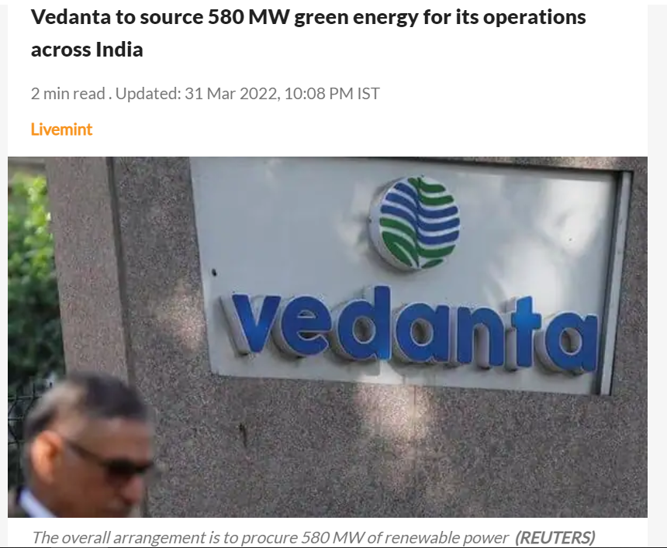
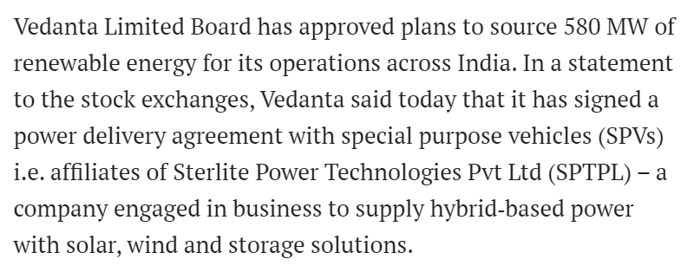
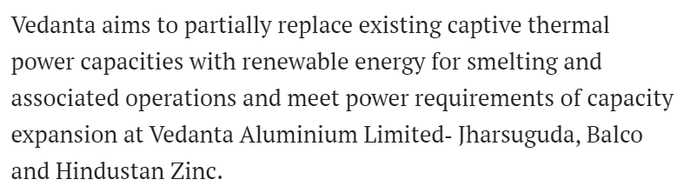
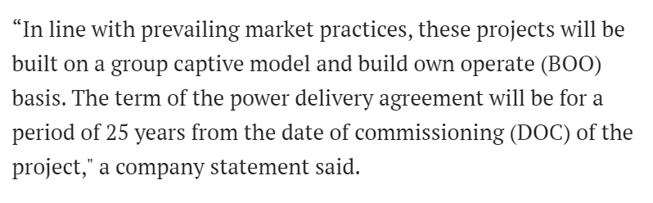
Open Access – Vedanta to source 580 MW green power for its Operations
Notes:
https://www.livemint.com/news/india/vedanta-to-source-580-mw-green-energy-for-india-operations-11648742458441.html

Slide 31
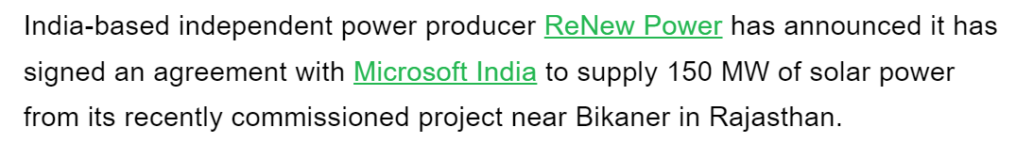
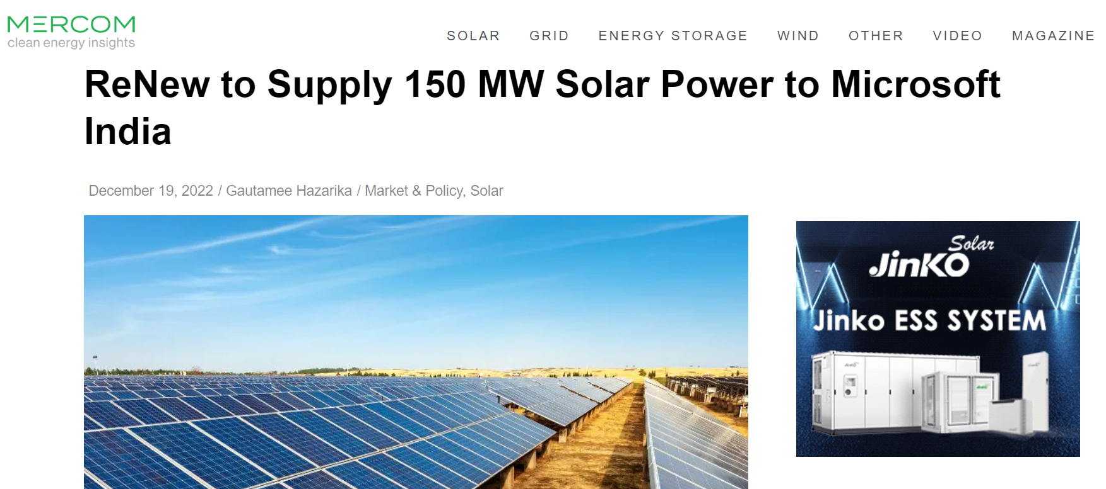
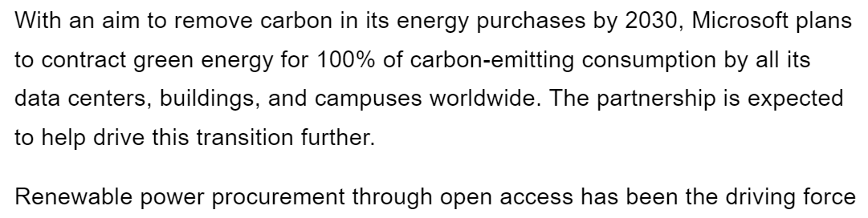
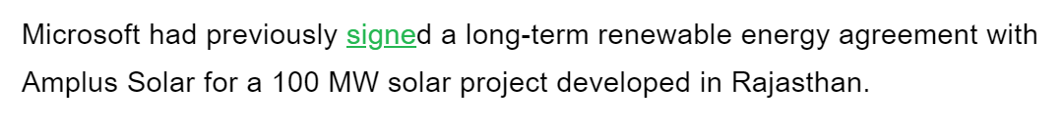
Open Access – Microsoft to source 150 MW green power from ReNew
Notes:
https://www.livemint.com/news/india/vedanta-to-source-580-mw-green-energy-for-india-operations-11648742458441.html

Slide 32
Concept of Power Trading
Definition
Trading means purchase of electricity for resale thereof (as per Electricity Act 2003)
Types of Contract
Short-term Contract: period of the contract is up to 1 year
Long-term Contract: period of the contract is more than 1 year
[as per CERC (Procedure, Terms and Conditions for grant of trading licence and other related matters) Regulations, 2020]
Potential buyers from trading licensees
Discoms, Power Exchanges, Open Access Consumers
Trading Margin
Short-term Contract: 0 paise/kWh to 7 paise/kWh
Long-term Contract: mutually decided between the Trading Licensee and the seller
[as per CERC (Procedure, Terms and Conditions for grant of trading licence and other related matters) Regulations, 2020]
Leading Power Traders in India and their Market Share
Names of Trading Licensees | % Share in total Volume transacted by Trading Licensees
Names of Trading Licensees | Apr ‘21 | May ‘21 | Jun ‘21 | Jul ‘21 | Aug ‘21 | Sep ‘21 | Oct ‘21 | Nov ‘21 | Dec ‘21 | Jan ‘22 | Feb ‘22 | Mar ‘22
PTC India Ltd. | 42% | 48% | 49% | 45% | 44% | 47% | 43% | 44% | 49% | 48% | 46% | 33%
NTPC Vidyut Vyapar Nigam Ltd. | 12% | 12% | 8% | 10% | 10% | 10% | 10% | 13% | 13% | 14% | 11% | 17%
Adani Enterprises Ltd | 12% | 10% | 5% | 5% | 5% | 6% | 14% | 9% | 7% | 5% | 8% | 12%
Tata Power Trading Company (P) Ltd. | 11% | 11% | 15% | 14% | 15% | 15% | 9% | 10% | 10% | 7% | 8% | 11%
Manikaran Power Ltd. | 7% | 6% | 9% | 10% | 8% | 7% | 7% | 8% | 6% | 7% | 6% | 7%
Source: CERC Monthly Reports on Short-term Transactions of Electricity in India
Notes:
https://cercind.gov.in/report_MM.html

Slide 33
4.B. Sale to Power Traders – Implications for CIL
Opportunity for CIL
CIL can sell its surplus/ untied solar energy generation through power traders.
For this, long-term contracts will be more preferable for CIL due to tariff certainty.
Condition for commercial viability
Sale to power traders will be commercially viable for CIL only when the selling tariff is greater than the cost of generation
Way Forward
Deliberations may be made with the leading power traders to understand the opportunity for power sale through the traders.

Slide 34
5. CPSU Scheme

Slide 35
CPSU Ph-II Scheme
Government of India, through Ministry of New & Renewable Energy (MNRE) has approved the implementation of CPSU Scheme Phase-II for setting up 12,000 MW grid-connected Solar Photovoltaic (PV) Power Projects by CPSUs/ State PSUs/ Government Organizations, with Viability Gap Funding (VGF) support, for self-use or use by Government/ Government entities, either directly or through Distribution Companies (DISCOMS).
12000 MW Grid Connected Solar PV
Only for Government Producers
For Self/ Govt. Entities’ Consumption
Bidding by IREDA based on Viability Gap Funding (VGF)
“a) directly controlled by the Central or State Government or
b) is under the administrative control of Central or State Government or
c) a company in which Government is having more than 50% shareholding.
“a) directly controlled by the Central or State Government or
b) is under the administrative control of Central or State Government or
c) a company in which Government is having more than 50% shareholding.
“a) Maximum Rs. 0.55 Cr /MW, to be decided through bidding
b) VGF will be released in two tranches as follows:
i.50% on Award of contract to the EPC contractor
ii. Balance 50% on successful commissioning of the full capacity of the project
“Indian Renewable Energy Development Agency Limited (IREDA) is the Implementation Agency which will allocate the VGF fund by bidding using bucket filling method”
Rs. 2.45/kWh
Capping for Tariff
30 months from LOA
Commissioning Timeline

Slide 36
Results of tenders under CPSU Scheme (1/2)
SECI 922.4 MW (out of 2 GW) TRANCHE I
e-RA date: 20th Aug 2019
Bidder's Name | VGF quoted (INR/MW) | Awarded capacity (MW) | Capped Tariff
NHDC Limited | 55,00,000 | 25 | Rs. 3.50/kWh
THE SINGARENI COLLIERIES COMPANY LIMITED | 60,00,000 | 90
ASSAM POWER DISTRIBUTION COMPANY LIMITED | 68,00,000 | 30
DELHI METRO RAIL CORPORATION LIMITED | 69,75,000 | 3
NALANDA UNIVERSITY | 69,95,555 | 5
NTPC Limited | 70,00,000 | 769
TOTAL CAPACITY AWARDED (MW) |  | 922
SECI 1104.8 MW (out of 1.5 GW) TRANCHE II
e-RA date: 8th Nov 2019
Bidder's Name | VGF quoted (INR/MW) | Awarded capacity (MW) | Capped Tariff
THE SINGARENI COLLIERIES COMPANY LIMITED | 68,00,000 | 81 | Rs. 3.50/kWh
Indore Municipal Corporation | 68,80,000 | 100
NTPC Limited | 70,00,000 | 923 (out of quoted 1104 MW)
TOTAL CAPACITY AWARDED (MW) |  | 1,104

Slide 37
Results of tenders under CPSU Scheme (2/2)
IREDA 5 GW TRANCHE III
e-RA date: 23rd Sep 2021
Bidder's Name | VGF quoted (INR/MW) | Awarded capacity (MW) | Capped Tariff
SJVN Limited | 44,72,000 | 1,000 | Rs. 2.45/kWh
NLC India Limited | 44,74,990 | 510
NHPC Limited | 44,90,000 | 1,000
IRCON International Limited | 44,94,000 | 500
NTPC Limited | 44,95,000 | 1,990
TOTAL CAPACITY AWARDED (MW) |  | 5,000
Way Forward for CIL
Liaising with IREDA to understand future tender timelines
Liaising with State DISCOMs to find probable buyers
Exploring potential for use of power through captive consumption; subject to confirmation of future tenders

Slide 38
6. Captive Consumption

Slide 39
Criteria for Captive Power Project (CPP) as per the Electricity Rules 2005
Summary of the CPP criteria
Ownership Criteria
Energy Consumption Criteria
Special Provisions for SPV
Single Captive User- Holding of Minimum 26% Ownership of the CPP.
Group Captive User- Collective holding of minimum 26% ownership of the CPP
(“Ownership” as per Electricity Rules 2005 means equity share capital with voting rights)
Single Captive User- Consumption of minimum 51% of the annual electricity generated by the CPP.
Group Captive Users (Association of Persons)-
Collective consumption of minimum 51% of the annual electricity generated by the CPP.
Individual Group Captive User to annually consume electricity in proportion to its shareholding with a permissible variation of +/- 10%.
CPP can be formed as an SPV.
For SPV, one or multiple unit(s) of a Power Plant can be identified for captive use and not the entire Power Plant in order to satisfy the above two criteria.
(“SPV” as per Electricity Rules 2005 means a legal entity owning, operating and maintaining a generating station and with no other business or activity to be engaged in by the legal entity)

Slide 40
Types of Captive that can be implemented
Types of Captive
Intrastate
Interstate
Only State Grid is involved
CTU Grid involved with possible involvement of State grid if applicable

Slide 41
Key Requisites for Financial Viability of the Captive Power Plant
Landed Solar tariff at consumption points of CIL subsidiaries should be less than the DISCOM Energy Charge Rate payable by the Consumer Subsidiaries
Stacking up of charges from Generation end to Consumption end to arrive at Landed Solar Tariff:
Solar Generation Tariff in Solar Plant
ISTS Losses*
STU Charges and Losses
DISCOM Wheeling Charges and Losses
Landed Solar Tariff at consumption-end
Key Enabler: ISTS Waiver
*Not applicable for intrastate captive open access
ISTS Waiver - The MoP Order no. 23/12/2016-R&R dated 23.11.2021 and amendment of CERC (Sharing of InterState Transmission Charges and Losses) Regulations, 2020 dated 07.02.2023 provides for waiver of Inter State Transmission charges (ISTS) on solar energy generation projects (including captive projects) for projects commissioned within 30.06.2025
Key Considerations and Way Forward for CIL
Assessment of commercial viability required; landed solar tariff has to be less than DISCOM tariff
Since STU Grid would be utilized, liaising would be required to understand and expedite with regards to the State OA regulations and its associated clearances respectively

Slide 42
Status of solar power projects auctioned since March 2020

Slide 43
Status of Solar Power Projects awarded through e-Reverse Auctions since March 2020
~26.5 GW* of solar capacity tendered through e-Reverse Auctions (e-RA) since March 2020;
In FY 21, ~9.3 GW capacity was tendered, out of which only ~1.47 GW (~16%) have been commissioned as on date
Capacity corresponding to projects with approximate delay in PPA signing over 60 days from envisaged date : 10.6 GW
(Considering 4 months of timeline for SECI tenders and 2 months for Non-SECI tenders for signing of PPA)
Capacity of projects not commissioned for which timeline of over two years have already lapsed since e-RA: ~7 GW
(considering ~24 months from e-RA date: standard timeline of 1 month from e-RA for receipt of Letter of Award, 1-3 months for PPA signing and 18 months for commissioning from PPA date)
Capacity of tenders scrapped, LOA cancelled, or PPA pending to be signed (as on Oct 2022) post e-RA completion since March 2020: ~0.9 GW
*Assumption: Solar capacity of 50% considered for Hybrid configurations
The figures above are clearly indicative of the fact that the situation of projects under Tariff based Competitive Bidding (Sec 63) has been far from ideal.
Recent pandemic and price fluctuations of major capex components, as well as inherent difficulty to sign PPAs with DISCOMs have majorly contributed to this current predicament
Supporting sheet:
Note: Above analysis is based on secondary research and market intelligence

Slide 44
Deloitte refers to one or more of Deloitte Touche Tohmatsu Limited, a UK private company limited by guarantee (“DTTL”), its network of member firms, and their related entities. DTTL and each of its member firms are legally separate and independent entities. DTTL (also referred to as “Deloitte Global”) does not provide services to clients. Please see www.deloitte.com/about for a more detailed description of DTTL and its member firms.
This material has been prepared by Deloitte Touche Tohmatsu India LLP (“DTTI LLP”), a member of Deloitte Touche Tohmatsu Limited, on a specific request from you and contains proprietary and confidential information. This material may contain information sourced from publicly available information or other third party sources. DTTI LLP does not independently verify any such sources and is not responsible for any loss whatsoever caused due to reliance placed on information sourced from such sources. The information contained in this material is intended solely for you. Any disclosure, copying or further distribution of this material or its contents is strictly prohibited.
Nothing in this material creates any contractual relationship between DTT ILLP and you. Any mutually binding legal obligations or rights may only be created between you and DTTI LLP upon execution of a legally binding contract. By using this material and any information contained in it, the user accepts this entire notice and terms of use.
©2022 Deloitte Touche Tohmatsu India LLP. Member of Deloitte Touche Tohmatsu Limited
Deloitte Touche Tohmatsu India Private Limited (U74140MH199 5PTC093339), a private company limited by shares, was converted into Deloitte Touche Tohmatsu India LLP, a limited liability partnership (LLP Identification No. AAE-8458),with effect from October 1, 2015.

Slide 45
Annexure 1: ECR of RVUNL Coal TPPs for FY 22 and FY 23 (Till January 2023)
ECR Figures in Rs/kWh
BACK TO MAIN SLIDE
Source: RVUNL website, National Power Portal

Slide 46
Annexure 2: IEX GDAM Market Trends
Last 12 Months:
Total Scheduled Volume: 3,724 MU
(Solar: 1,571 MU; Non-Solar: 2,153 MU)
Weighted MCP for both Solar and Non-Solar : Rs. 5.71/ kWh
BACK TO MAIN SLIDE

